Slide 1
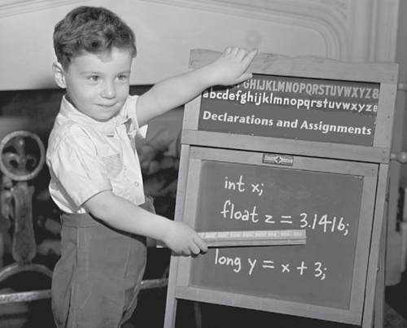
Java Programming
Variables and operators

Slide 2
Outline
Variables and Types
Operators and Expressions

Slide 3
Basics
There are two basic aspects of programming: data and instructions.
To work with data, you need to understand variables and types; to work with instructions, you need to understand control structures and subroutines.

Slide 4
Variables
Computer programs manipulate (or process) data.
A variable is a storage location (in the main memory) that stores a piece of data for processing.
Each variable has a name so that it can be easily referred to and used in a program.
It is called variable because you can change the value stored inside.

Slide 5
Variables
More precisely, a variable is a named storage location, that stores a value of a particular data type.
In other words, a variable has a name, a type and stores a value of that type.
Note: The programmer don’t need to worry about where in memory the variable is located, it is the compiler’s responsibility to keep track of the memory location.

Slide 6
Variable declaration statement
We must declare the variables before use them.
Syntax
type varName;
type varName1, varName2;
Note: in multiple-variable declaration, the names are separated by commas (,).

Slide 7
Identifiers
Identifiers can be used to name classes, variables, and subroutines.
It must begin with a letter or underscore and must consist entirely of letters, digits, and underscores. (“Underscore” refers to the character ’_’)
Some legal identifiers:
N i j student_name studentID

Slide 8
Keywords
Keywords are the words preserved by Java, which are used by the compiler to analyze the structure of the program.
Keywords are not allowed to use as identifiers.
In the Hello.java, the keywords include package, public, class, static, void, and int.

Slide 9
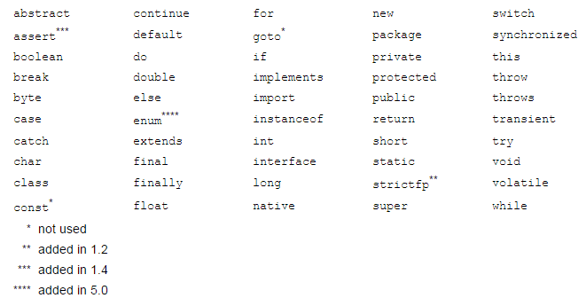
Keywords
You can find the complete list of keywords at http://docs.oracle.com/javase/tutorial/java/nutsandbolts/_keywords.html

Slide 10
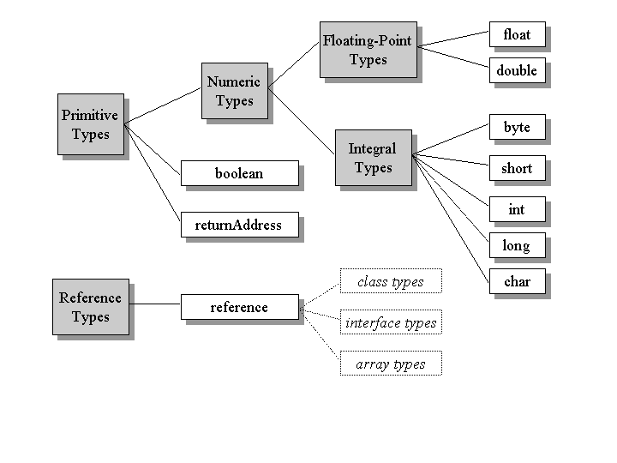
Types

Slide 11
Primitive Types
There are eight primitive types built into Java:
byte, short, int, long, float, double, char, and boolean.
For example:
boolean: Truth value (true or false).
int: Integer (0, 1, -47).
double: Real number (3.14, 1.0, -2.1).

Slide 12
Primitive Types
byte holds 8 bits
Value range: -128 and 127
short, two bytes (16 bits)
Value range: -32768 to 32767.
int, four bytes (32 bits)
Value range: -2147483648 to 2147483647.
long, eight bytes (64 bits)
Value Range: -9223372036854775808 to 9223372036854775807.

Slide 13
Primitive Types
float, 2 bytes, 7 significant digits
Value range: (+/-) 1.4E-45 to 3.4028235E38
double, 4 bytes, 15 significant digits
Value range: (+/-) 4.9E-324 to 1.7976931348623157E308
char, 2 bytes
A single character from traditional ASCII character or Unicode characters that come from different languages.
Boolean, ? bytes
true or false

Slide 14
A reference type: String
String is a type, but not a primitive type; it is in fact the name of a class which we will introduce in future lectures.
A value of type String is a sequence of characters. We’ve already seen a string value: "Hello World!"

Slide 15
Escape sequences
Some characters are hard to type. For these characters Java provides escape sequences.
\b backspace
\t tab
\n linefeed
\r carriage return
\" double quote, "
\' single quote, '
\\ backslash, \

Slide 16
Assignment
Use = to give variables a value. String foo, story; foo = “My name is Tom, I’m 7 years old.”; story= “Tom said:\”I like Java!\””;
Can be combined with a variable declaration. double Pi = 3.14; boolean isJanuary = true;

Slide 17
Literals
A literal is something that you can type in a program to represent a value. It is a kind of name for a constant value.

Slide 18
Literals
int a = 45, b = 045, c = 0x45, d = 0XFF1A;
int x = 0b110, y=0B110;
float a = 1.0, b = 1.0f, c = 1.3e12F, d = 1.3E-12F;
double a = 1.0, b = 12.3737e-108;
char a = ’a’, b = ’\n’, c = ’\u00E9’;
boolean a = true, b = false;
String a = “a”, b = “Hello world!”;

Slide 19
Notice
Any numeric literal that contains a decimal point or exponential is a literal of type double. To make a literal of type float, you have to append an “F” or “f” to the end of the number.
The single quotation marks and double quotation marks are not part of the actual value!

Slide 20
State of program
At one moment, the variables in a program and their current values make up the state of program
We can check the state of program to debug the program.
Debugging is to check whether the state of program meet our expectation.

Slide 21
Conversion by casting
int a = 18; // correct
double = 18.7; // correct
int a = 18.7; // compile-error
int a = (int)18.7; // a = 18 (Explicit casting)
double a = 2; // a = 2.0 (Implicit, legal but bad style)
double a = 2/3; // a = 0.0 (may cause runtime-error)
double a = (double)2/3; // a = 0.6666…

Slide 22
Conversion by casting
Implicit casting (widening conversion)
A data type of lower size is assigned to a data type of higher size.
This is done implicitly by the JVM. The lower size is widened to higher size.
This is also named as automatic type conversion.

Slide 23
Conversion by casting
Explicit casting (narrowing conversion)
A data type of higher size cannot be assigned to a data type of lower size. Otherwise , it will raise a compilation error "possible loss of precision".
This is not done implicitly by the JVM and requires explicit casting; a casting operation to be performed by the programmer.

Slide 24
Conversion by casting
“size” of primitive types
byte < short < int < long < float < double
Note:
Casting between char and short
The char and short, each takes 2 byte of memory.
Either char to short or short to char requires explicit casting.
A boolean value cannot be assigned to any other data type.

Slide 25
Try it
public class MyFloatPrecesion {
public static void main(String[] args) {
System.out.println((float)32.3989211134);
System.out.println((float)32.3989214399);
}
}

Slide 26
Rounding errors
The difference between the number we want and the floating-point number we get is called rounding error.
System.out.println(0.1 + 0.1 + 0.1 + 0.1 + 0.1 + 0.1 + 0.1 + 0.1 + 0.1 + 0.1);
On many machines, the output is 0.9999999999999999

Slide 27
Comments
Comments in a program are entirely ignored by the computer; they are there for human readers only. There are two types of comments.
Single line comment
begins with // and extends to the end of a line.
Multiple lines comment
starts with /* and ends with */
Javadoc comment
begins with /**(two stars) and end with */ (one star).
Notes:
“Javadoc” comment can be used to produce documentation for the program.

Slide 28
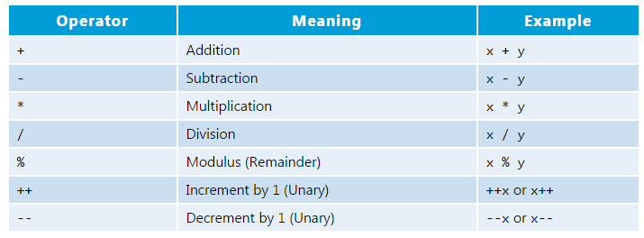
Arithmetic Operators
Symbols that perform simple computations.
Note: Division (“/”) operates differently on integers and on doubles!

Slide 29
Arithmetic Operators
Addition, subtraction, multiplication, division and remainder are binary operators that take two operands (e.g., x + y);
while negation (e.g., -x), increment and decrement (e.g., ++x, --x) are unary operators that take only one operand.

Slide 30
Expressions
Expressions are generally a combination of values, variables, and operators.
Expressions also have types, as determined by their operators and operands.
When complied and executed, they will be evaluated as a single value.
Some expressions:
hour * 60 + minute
1/3
8

Slide 31
More about Assignment
The LHS (Left-Hand Side) of '=' shall be a variable, while the RHS (Right-Hand Side) should be an expression;
That is, evaluate the RHS first, then assign the result to LHS.
x+1=y; //this is wrong

Slide 32
Statements
A statement is a line of code that performs a basic operation. Statement always ends with a semicolon (;).
int a; //variable declaration
double b=18.8; //variable declaration
b = b + 10.0; //assignment
System.out.println(“Hello world!”); //invokation

Slide 33
Composition
The ability to combine simple expressions and statements into compound expressions and statements.
Example:
System.out.println(10.5+(3-1)/(1+1));

Slide 34
Order of Operations
double x = 3 / 2 + 1; // x = 2.0
double y = 3 / (2 + 1); // y = 1.0
Precedence like math, left to right
Right hand side of = evaluated first
Multiplication and division precede over Addition and subtraction
Parenthesis increase precedence

Slide 35
String concatenation operator
float r = 12.0F;
String str = “The circular area with radius ”;
str = str + r + “ is: ”;
str = str + 3.1415926*r*r;

Slide 36
CalcArea.java
package hit.edu.java.intro;
public class CalcArea {
public static void main(String[] arguments) {
float r = 12.0F;
String str = “The circular area with radius ”;
str = str + r + “ is: ”;
str = str + 3.1415926*r*r;
System.out.println(str);
}
}

Slide 37
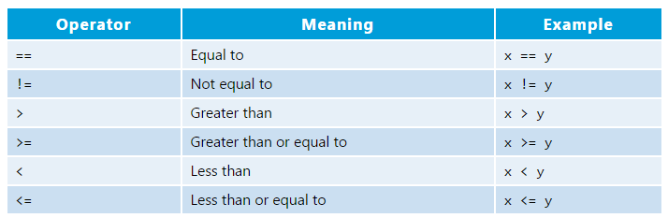
Relational operators
Relational operators are used to check conditions like whether two values are equal, or whether one is greater than the other.

Slide 38
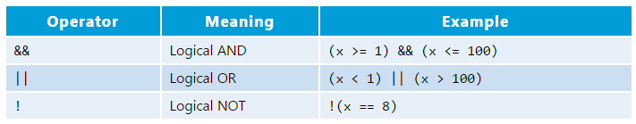
Logical operators
Note: 1<= x <=100 //this is wrong!
Example:
boolean A=true, B=false, C=true;
System.out.println(A && (B || C));

Slide 39
Quiz 1
Convert square feet to square meters:
we have known that 1 feet = 0.3048 meters.
there is a house with 3000 square feet, how much square meters it is?
Write some code to solve this problem

Slide 40


